Slide 1
Game of Thrones
By: Grant Doyle

Slide 2
Business Problem:
HBO is concerned that viewers will dislike Season 8 of Game of Thrones because the television show no longer has the Game of Thrones books to write their scrip off of. HBO wants to know what veiwer sentiment is, and what people on twitter are saying in regards to Season 8 Game of Thrones

Slide 3
Business questions to answer.
1. What is the overall sentiment of the Season 8 (The newest season) ?
2. What is the overall sentiment of Season 5 ?
3. How does this seasons reviews prepare to that of previous seasons?
4. What are some of the negative things are viewers are saying?
5. What are some of the things are viewers seem to enjoy?
6. Who are our most active twitter users?
7. What links are being shared in tweets?
8. What does our twitter network look like?

Slide 4
Data Identification and Collection
The first step in data collection will be web scraping from rotten tomatoes on the episodes in this season. We will be pulling in review scores and individual reviews from critics.¶
The second step in data collection will be mining data from twitter. We will target keywords and the popular hashtag that people use when talking about the show on twitter (#GameofThrones).

Slide 5
Web Crawling
Season 8 and Season 5
Totaling several hundred reviews
Only took Review Section

Slide 6

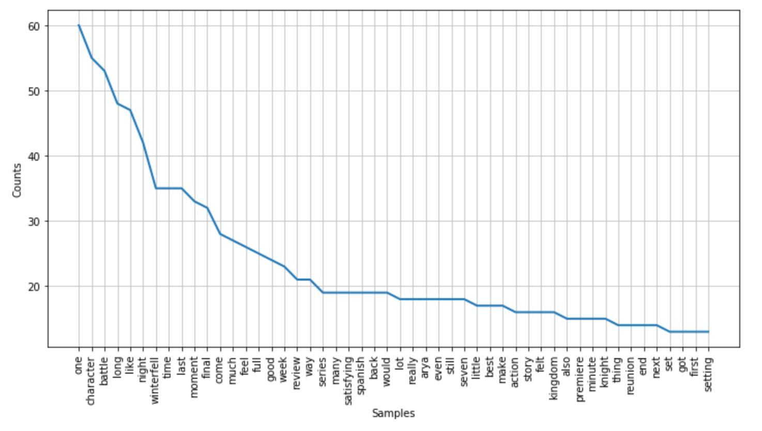
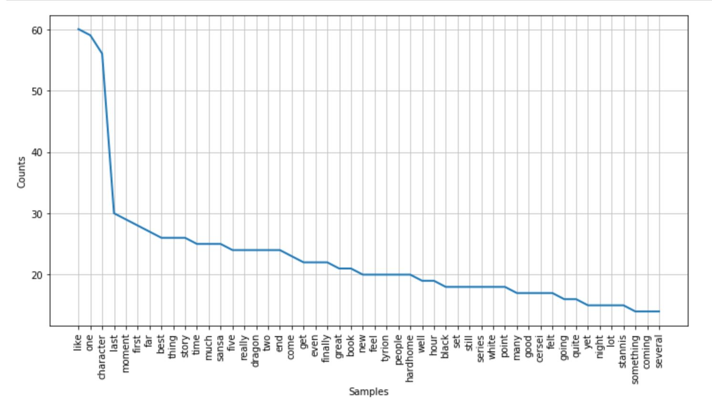
Findings: season 8(left) Season 5(right)

Slide 7
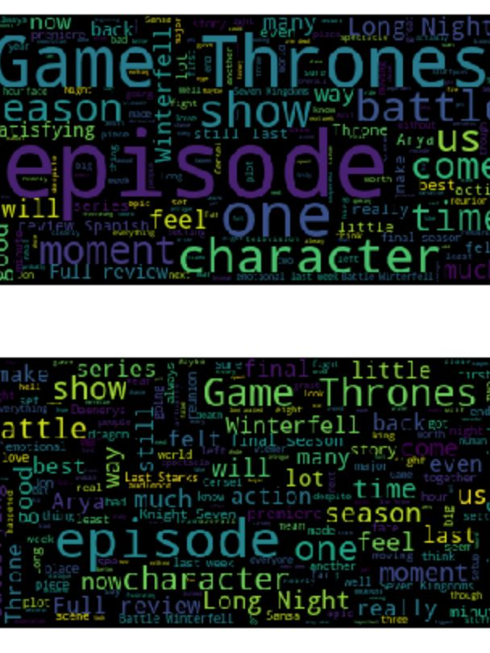
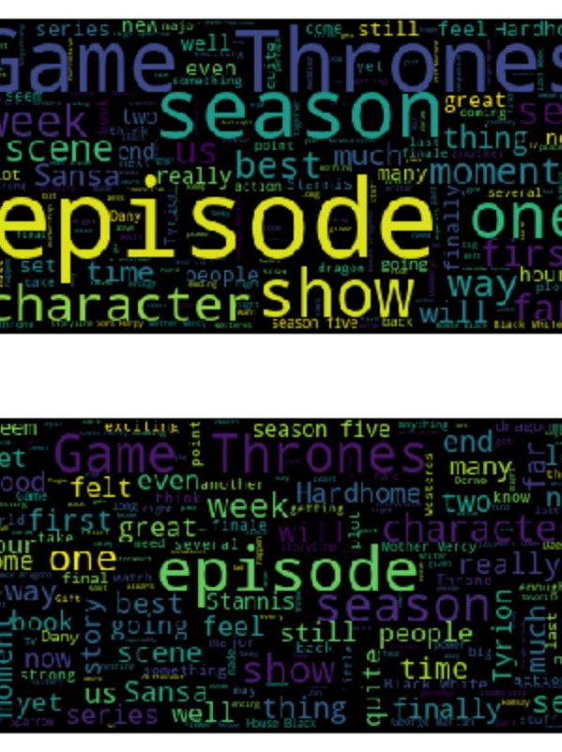
Findings Continued (8 left, 5 right)

Slide 8
Web Crawling Outcome
Not what I had anticipated
Showed only a 2% difference in sentiment analysis
Word Cloud for season 5 was character driven
Word Cloud for season 8 was ‘big picture’ driven

Slide 9
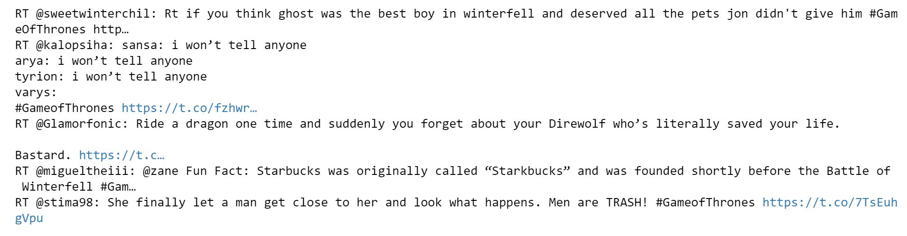
Twitter
Using the keyword: #GameofThrones
To see what people are saying
What content is being sent
Who are the biggest accounts

Slide 10
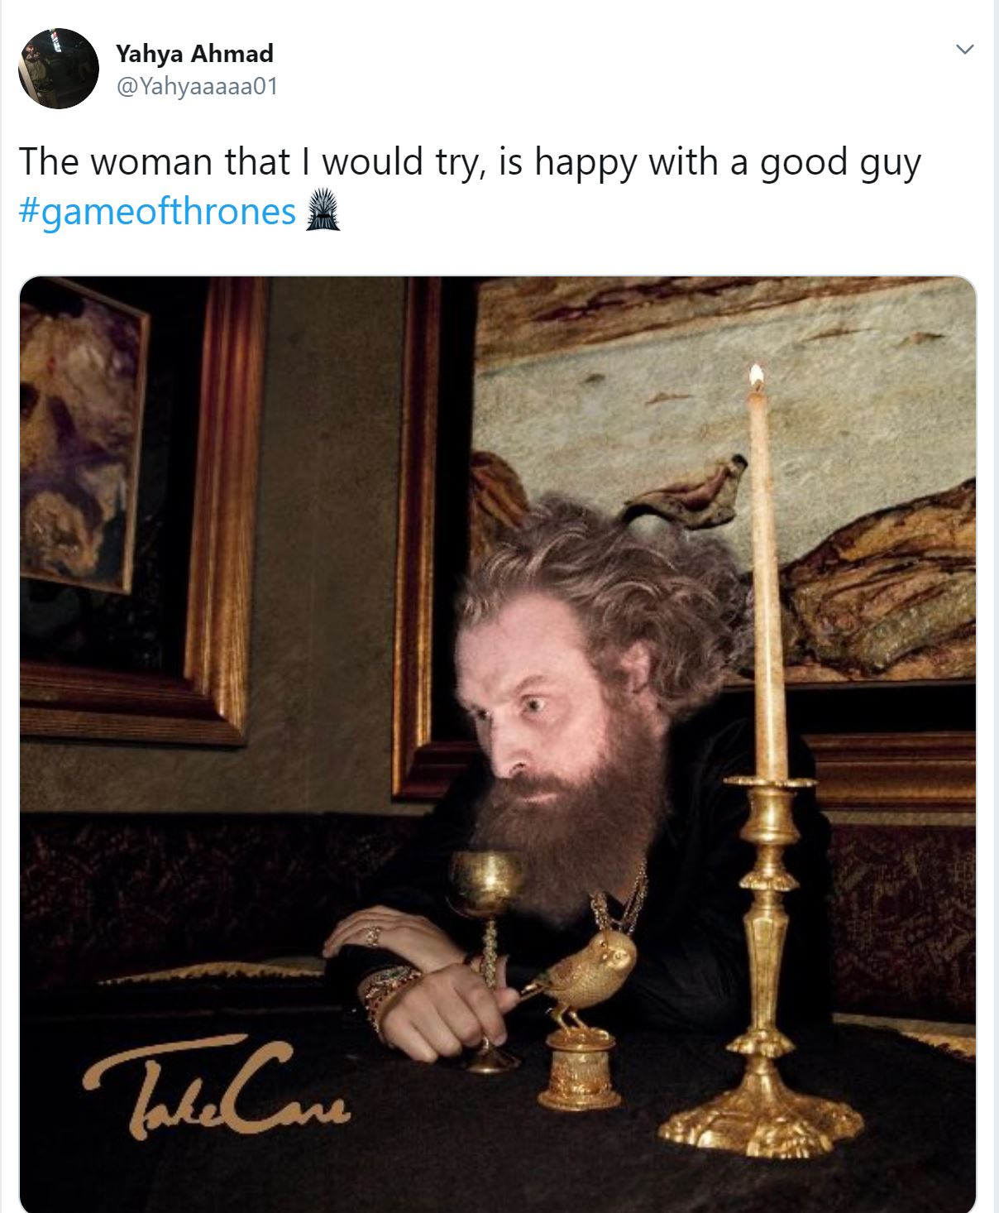
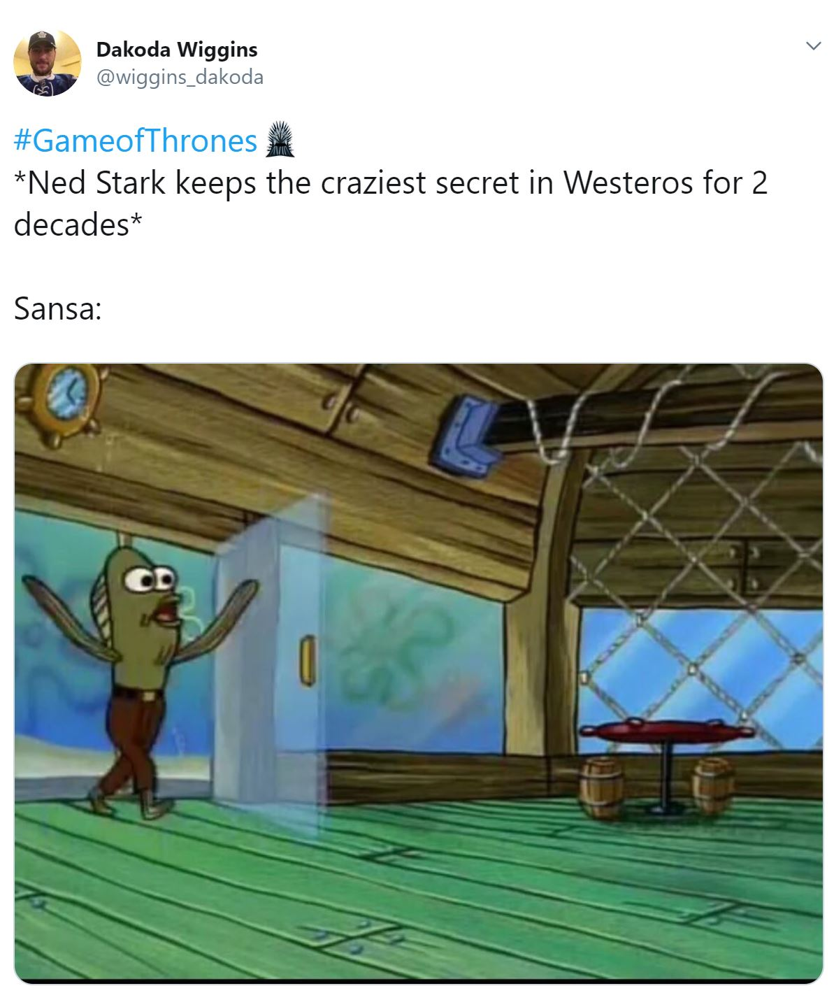
Findings:

Slide 11
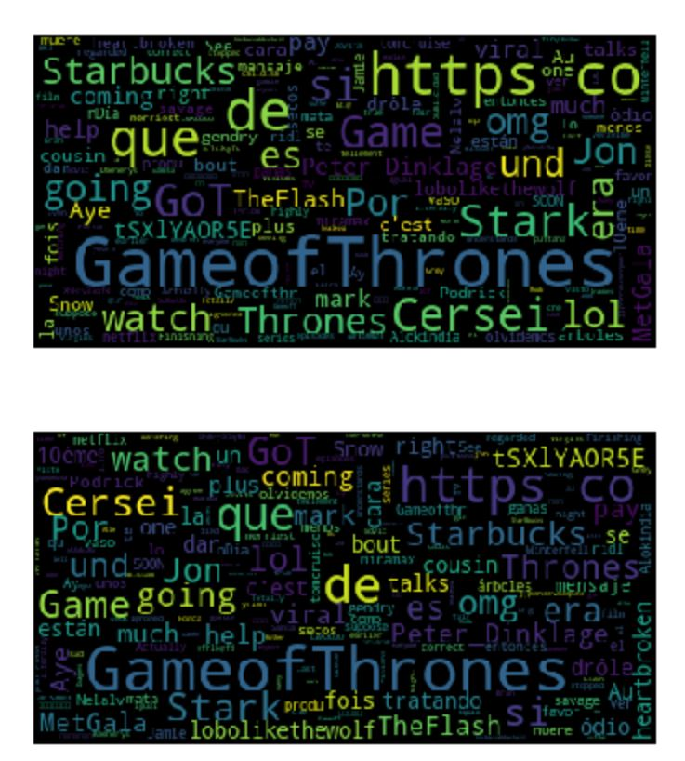
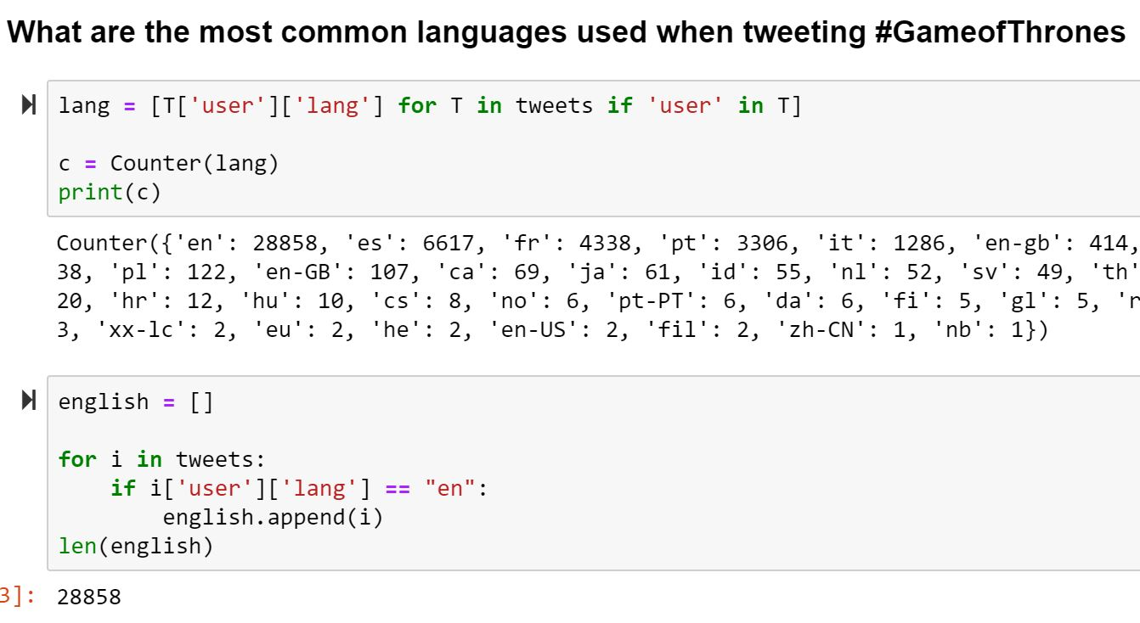
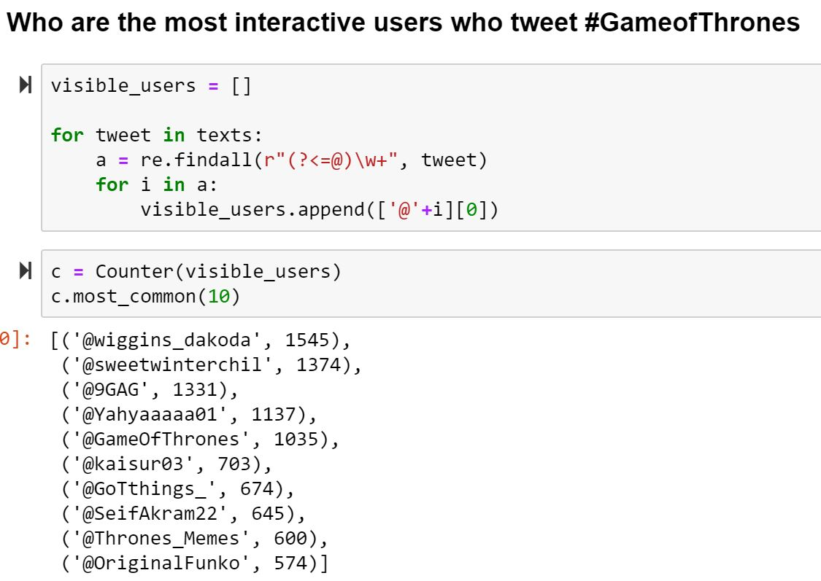
Findings cont:

Slide 12
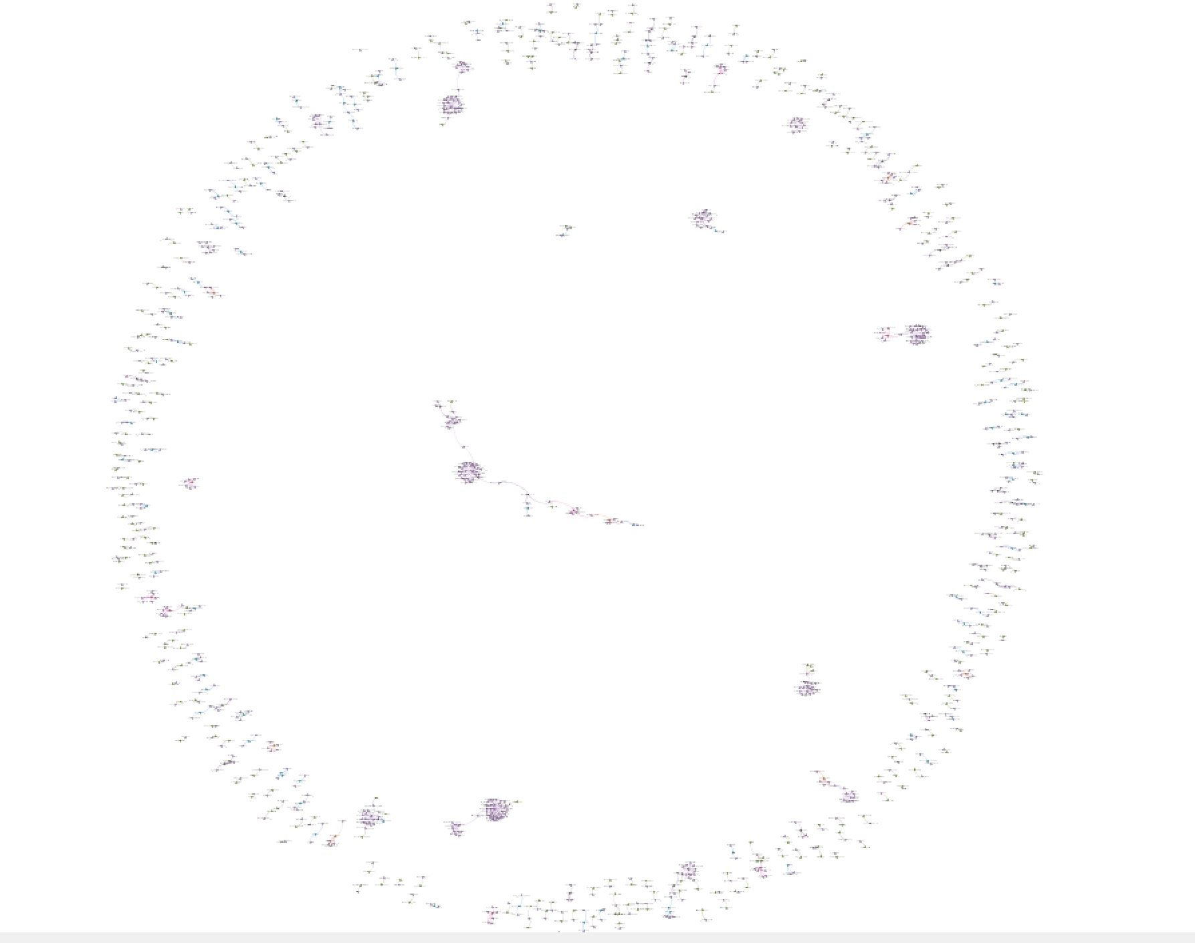
Network

Slide 13
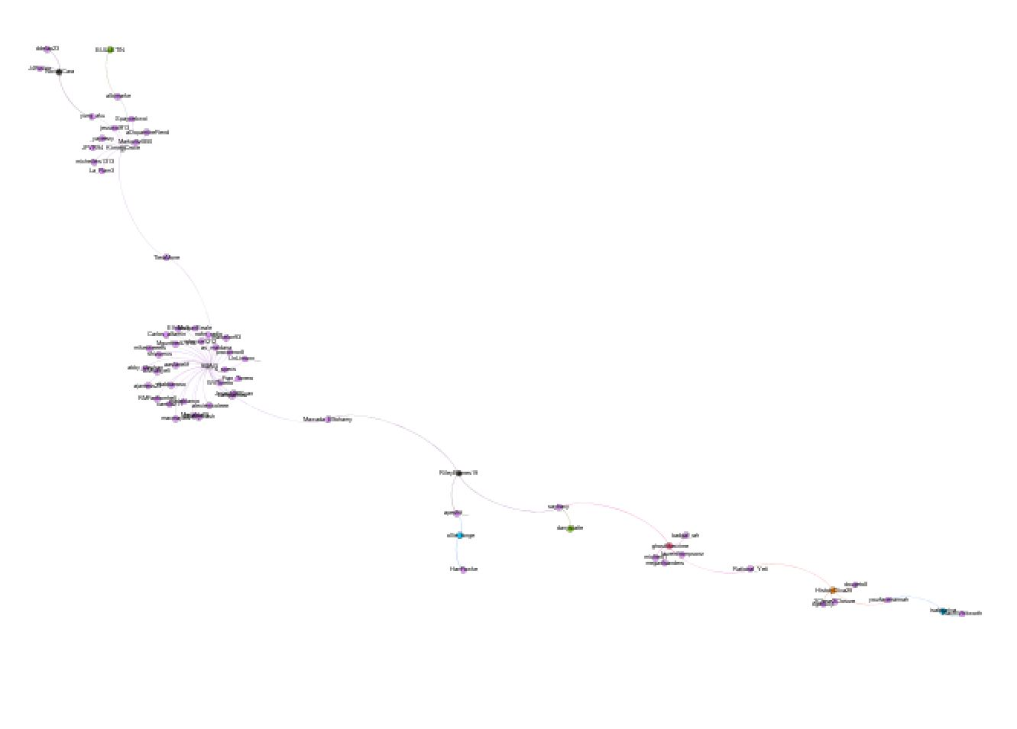
Network Cont:

Slide 14
Conclusion:
Business questions to answer.
1. What is the overall sentiment of Season 8 (The newest season) ?
- 44% positive Reviews
2. What is the overall sentiment of Season 5 ?
- 46% positive Reviews
3. How does this seasons reviews prepare to that of previous seasons?
- Increase 2%
4. What are some of the negative things are viewers are saying?
- Writing quality has decreased, many viewers still dislike cersci
5. What are some of the things are viewers seem to enjoy?
- They love battles, character feuds, dragons, and the white walkers
6. Who are our most active twitter users?
- wiggins_dakoda is the top with 1545 tweets, sweetwinterchil is second with 1374 tweets, and 9GAG is third with 1331 tweets. The GameofThrones account came in fourth
7. What links are being shared in tweets?
- Most links are image links used when making memes. Other than that they are articles to episode reviews and discussions.
8. What does our twitter network look like?
- Many people, but our network could be more collaborative.

